Slide 1
bongarde 2022 productivity hacks hybrid work arrangements
Bongarde 1.800.667.9300 info@bongarde.com

Slide 2
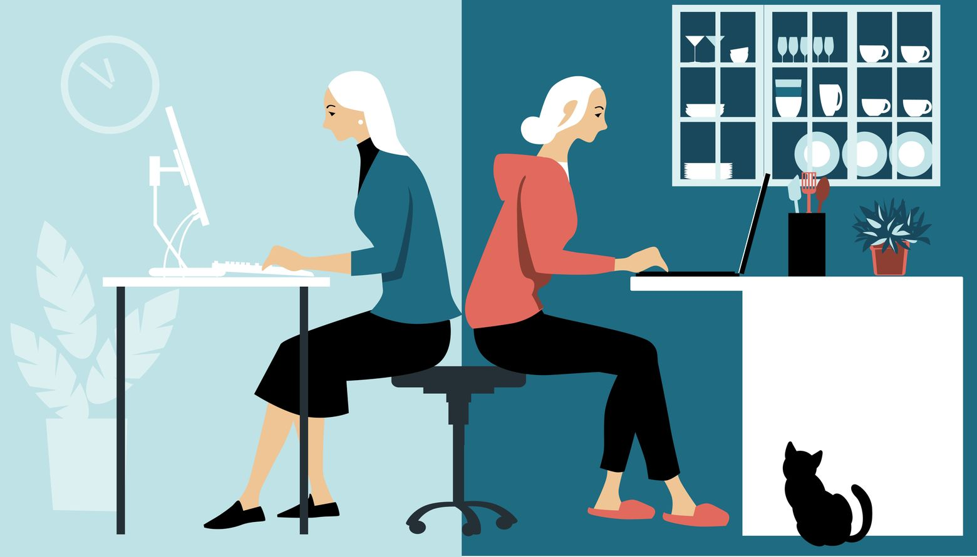
Hybrid work
Hybrid work predicted to boost productivity by over 4.5%
79% report better work/life balance
Only 36% employees engaged at work
13% actively disengaged

Slide 3
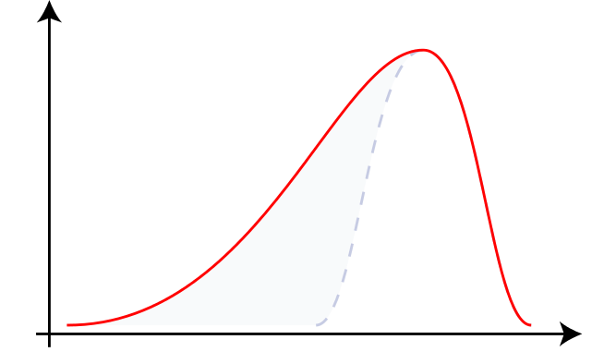
Bell curve
WHO? WHY?
Bongarde is a results driven organization
13% disengagement isn’t good-enough
13% can have 100% effect if in business development or CSM
Responsibility
Company
Culture
Individual

Slide 4
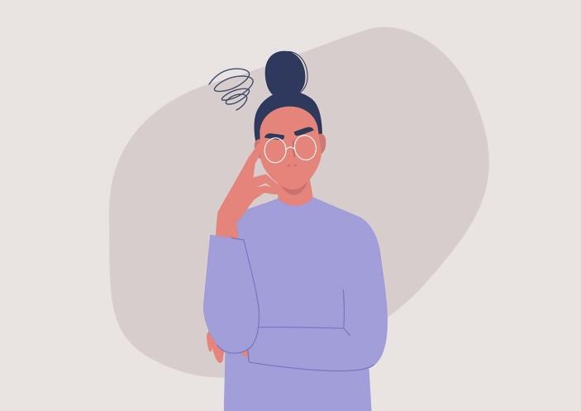
Productivity hacks
There are a lot of tried-and-true tactics for increasing your productivity, but just like our working lives are constantly evolving, so too are the ways in which we get the most out of our day. Productivity may look different depending on the circumstances of your role but incorporating a few productivity hacks into your routine can be a great way to get more out of each workday and your career overall.
Atomic Habits – Audible Account
Habits are what build a methodical system that helps you achieve progress and accomplish goals, and they form based on how frequently you engage in them, not just over time. Instead of changing habits by listing “what” you want, consider “who” you want to become or “how” you want to get there. This will enable you to work on a system to foster more positive, permanent results rather than continue to focus on short-term, singular, temporary goals.

Slide 5
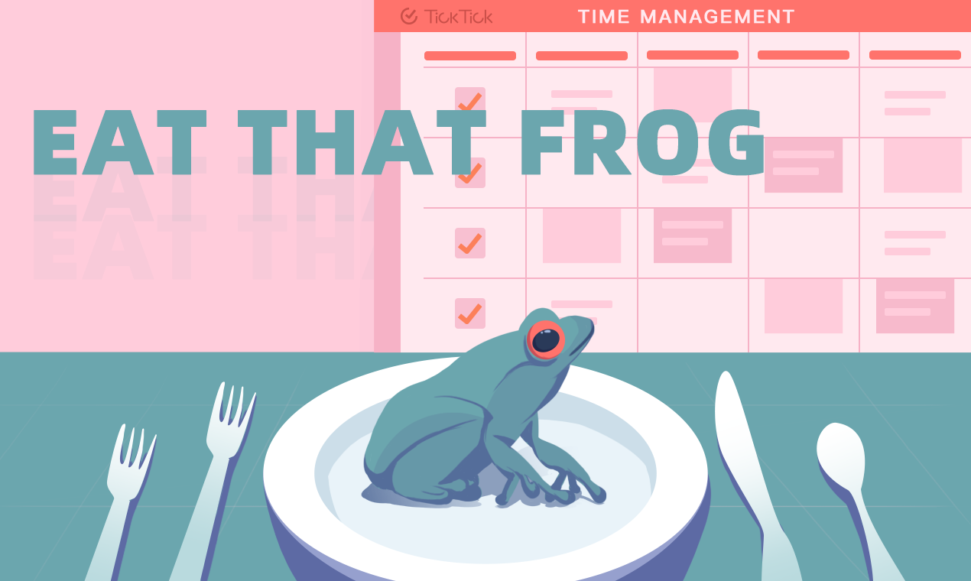
Productivity hacks
Set a single goal for each day
To forget about multitasking, you have to retrain your mind to concentrate on single tasks. This goes against everything our busy, digital lives encourages us to do but the solution to this problem also lies in the same digital tech that exacerbates it.
THE DAILY HIGHLIGHT
Instead of filling your to-do list with countless tasks every day, focus on a single must-do that you can consider your daily highlight. Start each day by asking yourself, “What do I want to get done today?” Adjusting your mindset from need to want can help facilitate a feeling of accomplishment where previously you may have felt defeated if you were unable to complete a lofty to-do list. Additionally, this practice will in turn help you better understand your priorities and consider the process it will take you to complete your daily must-do.
Don’t limit yourself to thinking of your daily highlight as strictly professional. There may be days where you need to prioritize your mental health with a personal or social must-do, even if it’s as simple as calling a family member or taking yourself out to lunch.
MIGHT-DO VS MUST-DO MINDSET
It may be too much to expect professionals to simplify their lives down to a single must-do, which is where you supplement your musts with mights. They may be just as important or necessary as your daily highlight, but they just didn’t make the #1 cut, and it will be okay if you don’t get to them today. There’s always tomorrow, after all. By reducing the demand you inflict on yourself, you may begin to feel better about your daily accomplishments and deliverables. In turn, productivity can improve and the feeling of being overworked could dissipate..

Slide 6
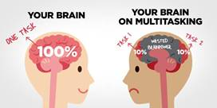
Productivity hacks
According to neuropsychologist Cynthia Kubu, PhD, “When we think we’re multitasking, most often we aren’t really doing two things at once, but instead, we’re doing individual actions in rapid succession, or task-switching,” That’s why things often fall through the cracks when we attempt to multitask, and we accomplish less than we think we should.
TIME BLOCKING
Exactly as it sounds, time blocking is when you dedicate chunks of time to singular tasks. Week by week, consider the things that are must-dos or goals and block out everything you’d need to do to prepare for them. Include everything from work projects to family commitments to appointments and personal goals—and carve out time for whatever you might need to prepare for them, such as research or reading time, phone calls, meals, and everything in between. Instead of jumping from task to task within the same hour, you now have each task blocked out in a more step-by-step format allowing for your full, undivided attention. This will not only ensure that you’re prepared for your must-dos, but it will protect your time so that you’re the one deciding where to spend it and distributing your efforts accordingly.
DELEGATING
It can be difficult to ask for help when you become overworked, but it’s completely acceptable and normal. Plus, delegating work ensures that the right tasks and projects are being completed by the right people, and it’s one way leaders can maximize their time at work. With effective delegation, leaders can focus on the bigger picture and outsource tasks to teammates who may be better suited to complete them. Collaborating to get the most work done with the amount of time you collectively have—that’s productivity.

Slide 7
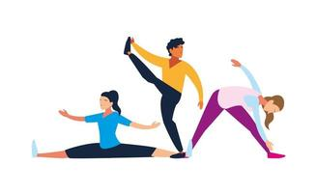
Productivity hacks
The benefits associated with exercise are vast and well-known—for instance, better sleep, more energy, decreased stress, and improved immune health—but it’s not often considered how activity can improve productivity.
Grogginess is the enemy of productivity. A round of exercise in the morning can kickstart your day and help you shake off the sleepiness. Productivity influencer Thomas Frank maintains that there are really only three things you need in the morning to get your brain geared up and in the right place:
Movement
Sunlight
Water
To assess whether exercising helps you feel more mentally capable to take on the world, try implementing a new routine for at least a week. Get outside and go on a jog first thing in the morning. Or, slow it down and go on a stroll, even if it’s just to your mailbox, to take your dog on a walk, or to take out the trash while still in your pjs. Then, when you return indoors, drink a glass of water and get the productivity ball rolling.
The takeaway here is the mindset shift. You can wake up earlier, but you may just sit in bed on your phone until it’s time to get to work or to your appointment. You can go outside to exercise but end up just turning back inside if the weather is less than ideal. All of these productivity tips are all useful, but only if you pencil them in, plan for them, and actually try them.

Slide 8
more
Do the hardest or most time-consuming task first “When we are overwhelmed and busy, we just go with easier tasks, and the difficult tasks tend to pile up.” —Maryam Kouchaki, management and organizations professor at Kellogg
Isolate from distractions “Turn off everything—email, phone, stock tickers, news, etc.—as often as possible and focus on a single task without interruption.” —Dianne McKeever, Co-Founder and Chief Investment Officer at Ides Capital
Review your week every Friday “Review your diary at the end of each week. Literally, print it out and review it. It will transform how you spend your time.” —Scott Farquhar, Co-CEO at Atlassian
Identify the time of day YOU are most productive and work around that “Understand how your brain works and when you are most productive. For me, I’ve gotten rid of lunch meetings to keep my productive time going as long as I can.” —Ryan Smith, CEO and co-founder of Qualtrics
Start with just five minutes “If you don’t want to do something, make a deal with yourself to do at least five minutes of it. After five minutes, you’ll end up doing the whole thing.” —Kevin Systrom, Co-Founder of Instagram

Slide 9
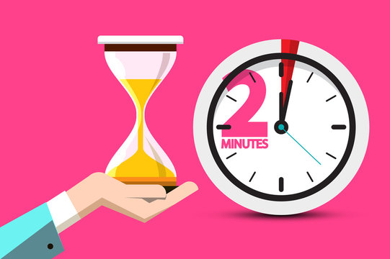
Productivity hacks
If a task presents itself to you that would take less than two minutes to complete, do it immediately.
Author David Allen popularized this method in his book, Getting Things Done. It’s one of the simplest ideas in this list, yet it’s also the one with the most profound potential impact. Here it is:
If a task presents itself to you that would take less than two minutes to complete, do it immediately.
That’s it.
Like a lot of great ideas, it seems obvious. But if you put it into practice, it can have a wide-reaching impact. An impact beyond making you more productive. I hesitate to call anything life-changing, but if you’re a procrastinator, the two-minute rule can change your life.
Skeptical? Try it for a day. That’s all it will take to convince you of its genius.

Slide 10
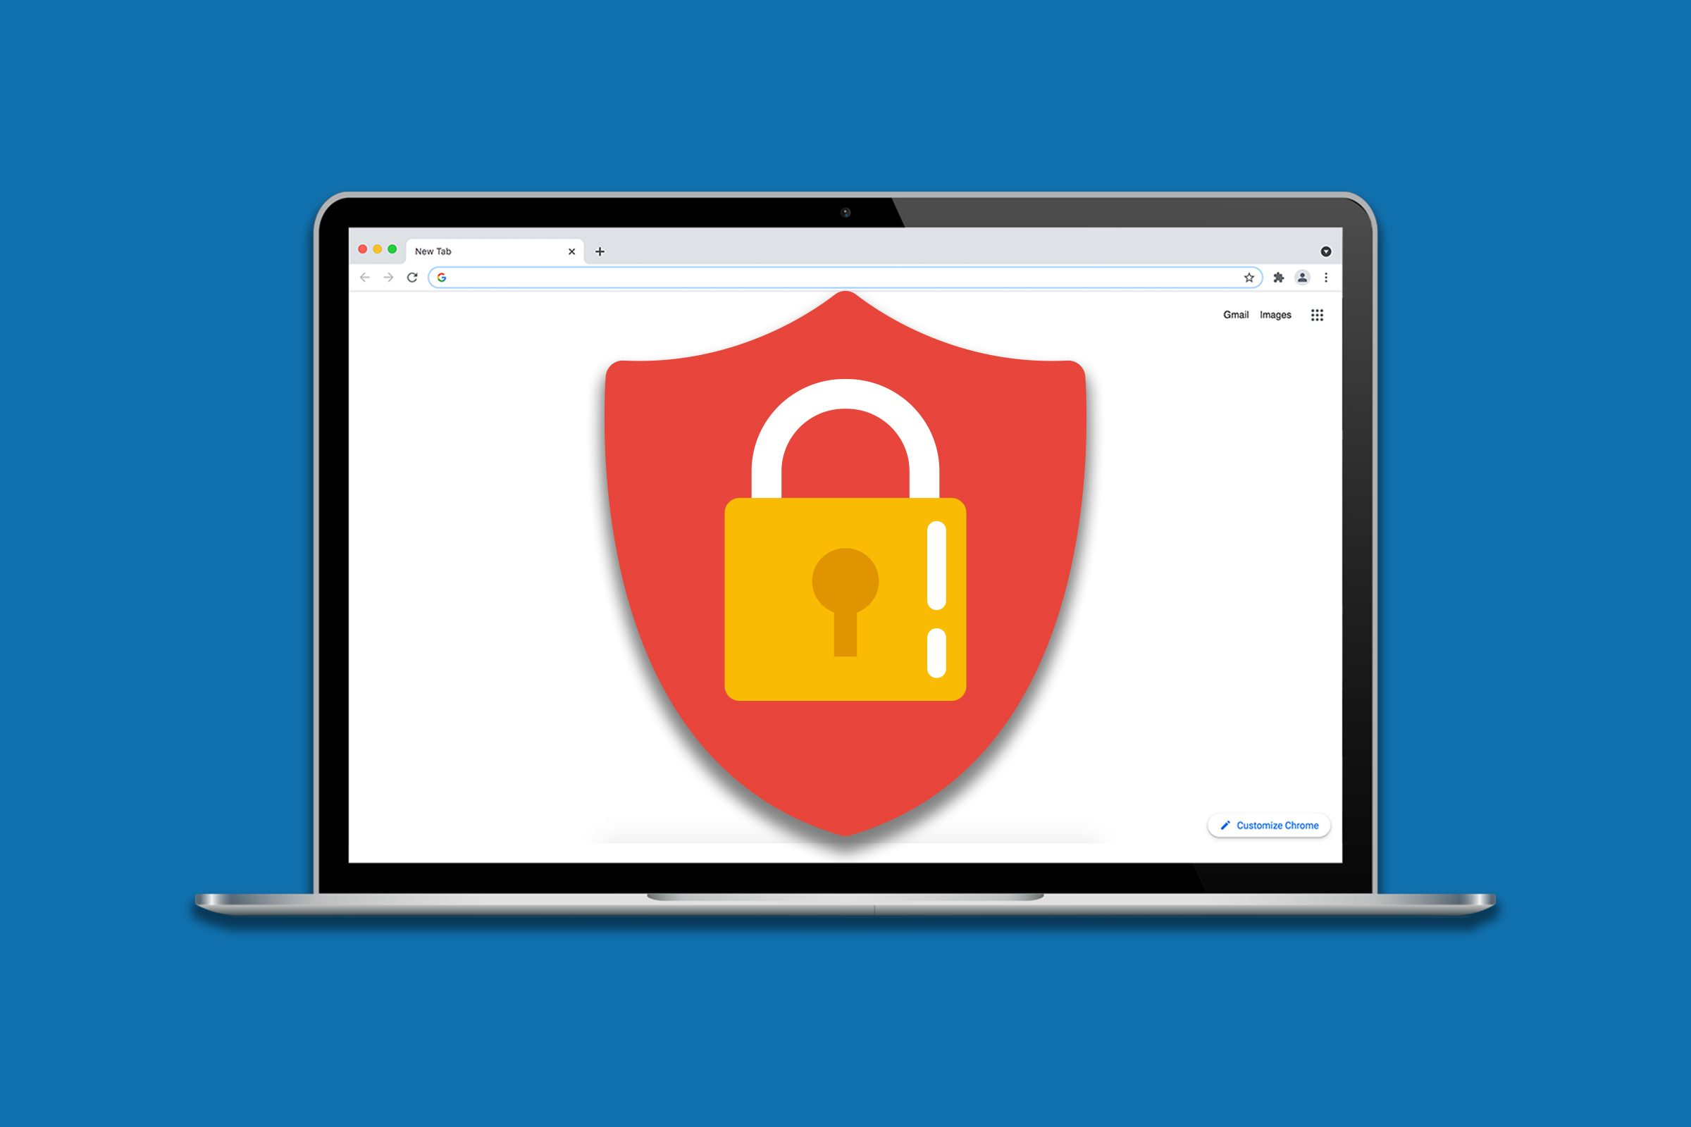
Productivity hacks
Block distracting apps/websites
According to research carried out by RescueTime, the average digital worker can’t go more than 6 minutes without checking their email or instant messaging. The digital nature of our work and social lives leaves us constantly checking for notifications and this constant distraction hampers our ability to focus on tasks for even short periods of time.
Some people think they are more productive when they:
Listen to music
Have videos on in the background
Keep their email open in another window
Etc.
Do you know the difference between white noise and noise?
YouTube / videos / movies / news
Twitch
Cellphone
Facebook
Non-work Chat / non-employee conversations
These are noise and examples of time theft.

Slide 11
Bongarde is a results driven organization. You need to do the work to get the results.
We ship on-time, at the highest quality, and we ALWAYS exceed expectations.

